Slide 1
Data-driven planning for Solid Waste Management in Chennai
Harsha Anantharaman

Slide 2




Slide 3
Contents
The need for a rational approach to MSWM Planning
The data collection and survey methodology developed in response to this need
Planning from Data: how data supports decision-making
The methodology developed for participatory planning
(Grounded in our experience in Ward 173, Chennai)
How these processes can be adapted to different contexts

Slide 4
The Need for a Rational Approach to MWSM planning
Our experience in ward 173

Slide 5
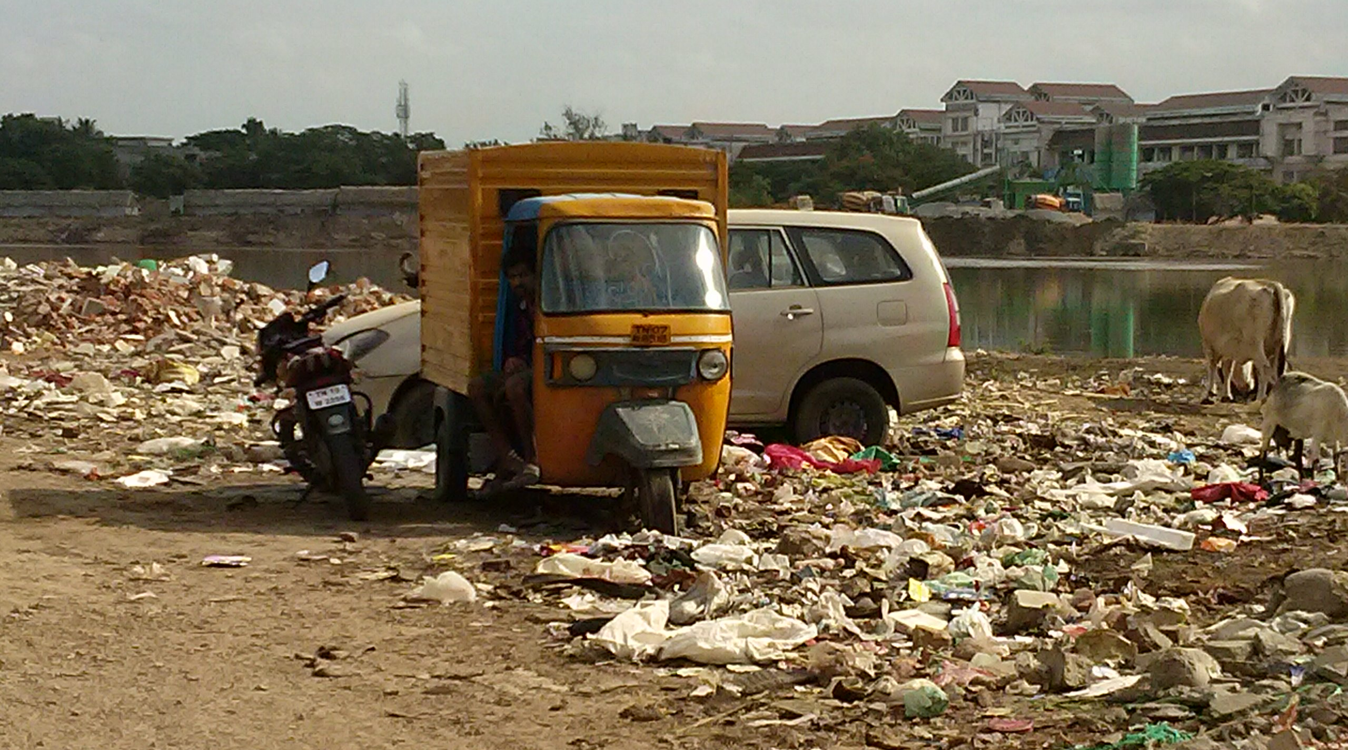
Area abutting the Adyar river: Ward 173
Resulting from the lack of waste Management service

Slide 6
Impact of poor data on SWm
Poor waste collection in general
Low income households become invisible and are not accounted for while planning waste collection systems
Leading to unhygienic disposal, pollution of waterways, local garbage dumps
No specialized mechanisms for dealing with special waste generators and bulk waste generators
Dumpsites are fast reaching capacity and scarcity of land underline the need for sustainable alternatives

Slide 7
Impact of poor data on SWm
Poor understanding of MSW and how to deal with it sustainably
Specifically:
No planning for resource recovery
Dumping of organic waste leading to higher greenhouse gas emissions
Unsanitary dumping of harmful and hazardous substances leading to pollution of ground water

Slide 8
An Example: Poor Data
Zone wise | Zone TPD | No. of Wards /Zone | Ward TPD (basis: zone) | No. of HH/ Ward | Waste generation/HH* | Waste generation/HH | Ward TPD (basis: per capita) | % diff. between col 3 & 7
Column | 1 | 2 | 3 | 4 | 5 | 6 | 7 | 8
Source | From RFP (CoC) | From RFP (CoC) | Col 1/2 | From RFP (CoC) | Col 3/4 | From Contract | Col 4*6 | Comparing
Zone 9 | 530 | 18 | 29.44 | 9222 | 3.19 | 2.4 | 22.13 | 33%
Zone 10 | 525 | 16 | 32.81 | 9563 | 3.43 | 2.4 | 22.95 | 43%
Zone 13 | 425 | 13 | 32.69 | 9000 | 3.63 | 2.4 | 21.60 | 51%
* In kgs. This column calculates the waste generation per household per day based on total waste generation and number of households. This data is provided in the Request For Proposal document.

Slide 9
An example: Impact of Poor Data
As per CoC documents, the number of households in Ward 173 is 9000
But the actual number of households in Ward 173 as per data collected in May-July 2014 is 14,443
Including small commercial establishments this number is 15,388: a difference of 41.5%
This explains the poor service provision and why the door-to-door collection and garbage clearance levels are so low!

Slide 10
A data collection and survey methodology
As implemented in ward 173

Slide 11
What do we need to know
The number and location of different categories of waste generators in the ward i.e. the households, small businesses and bulk waste producers
Total and per capita waste generation in Ward 173
Composition of waste generated
Potential sites for decentralized waste processing facilities
Waste management habits

Slide 12
Methodology
To collect this data requires a two pronged methodology:
Mapping to collect
  Location and numbers of different waste generators
  Logistical information for planning (open spaces, roads, terrain, etc.)
Sample survey to collect information on kind of waste generated, present methods of disposal, and present habits of waste management

Slide 13
Methodology
Mapping Ward 173
Detailed mapping of every household, shop, bulk waste producer and other infrastructure in the Ward
Paper mapping with the help of volunteers – low cost, easily replicable, greater accuracy, but more time consuming than GPS devices
Data collected over a period of two months, digitised using QGIS for analysis.
250 man-hours

Slide 14
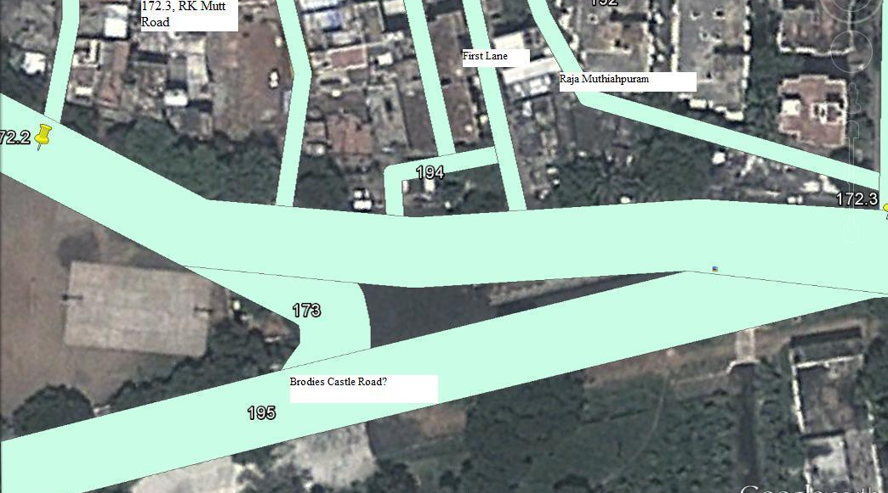
Paper Mapping: Unmarked segment
Printed MAPS are used to map manually with accompanying data sheets

Slide 15
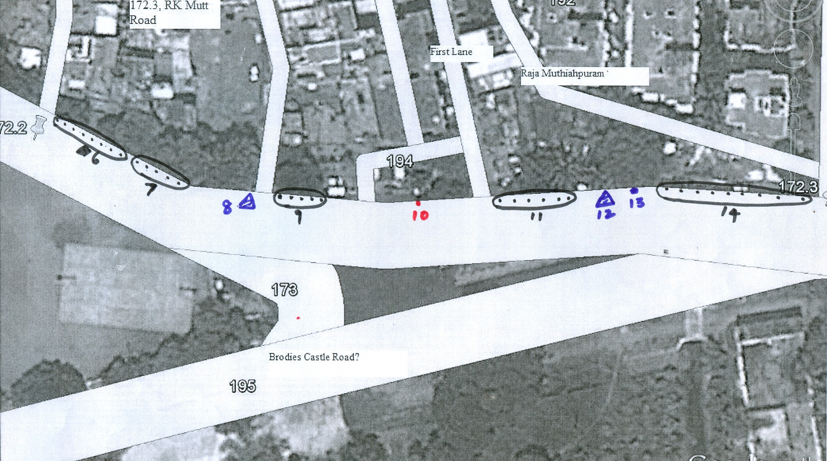
Paper Mapping: A marked Segment
Showing clusters, dumpsters, a BWP, and a shop

Slide 16
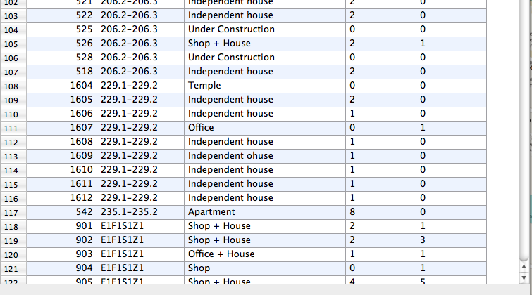
Screenshot of qgis showing non-bulk data
Unique ID with segment, type of infrastructure, no. of hH and shops

Slide 17
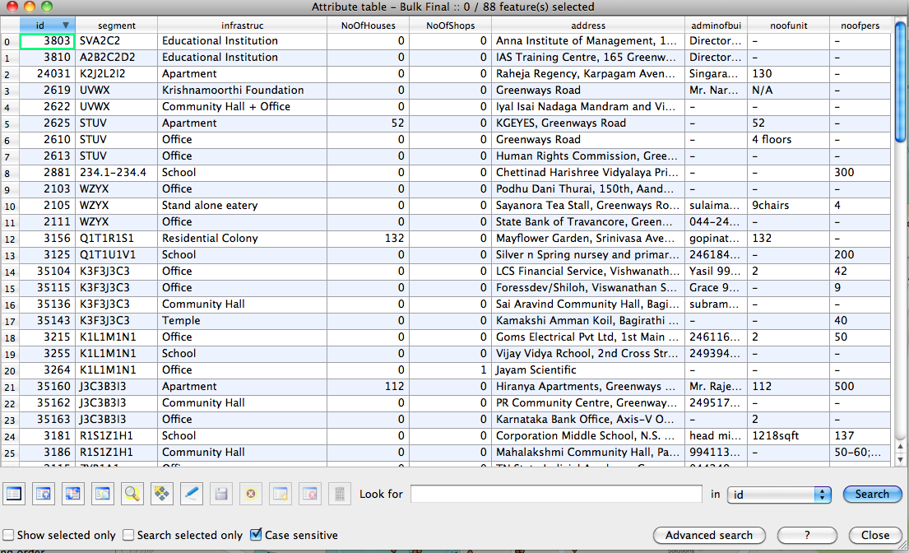
Screenshot of qgis showing bulk data
Unique id, type, no. of hH/shops, add, contact details, etc.

Slide 18
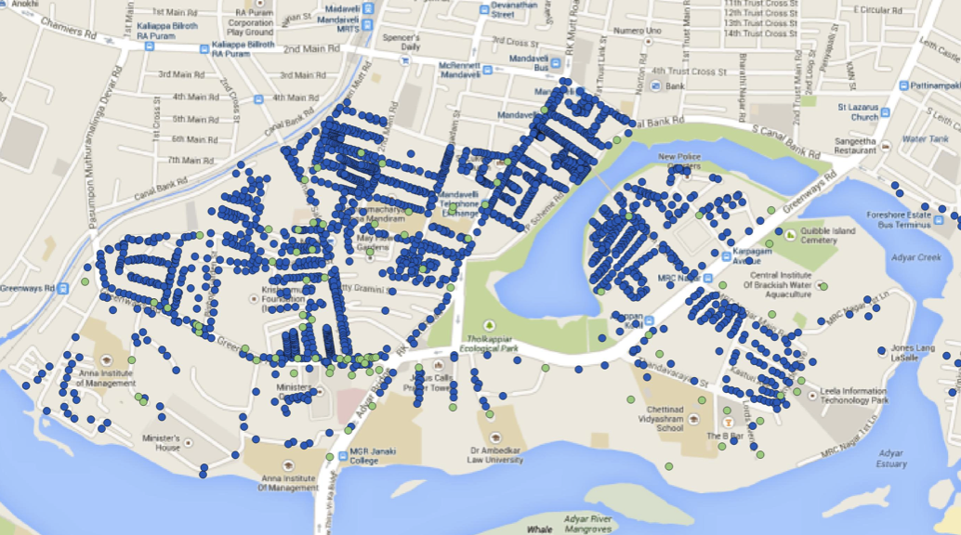
Ward 173 mapped data
Blue indicate non bulk, green indicate bulk

Slide 19
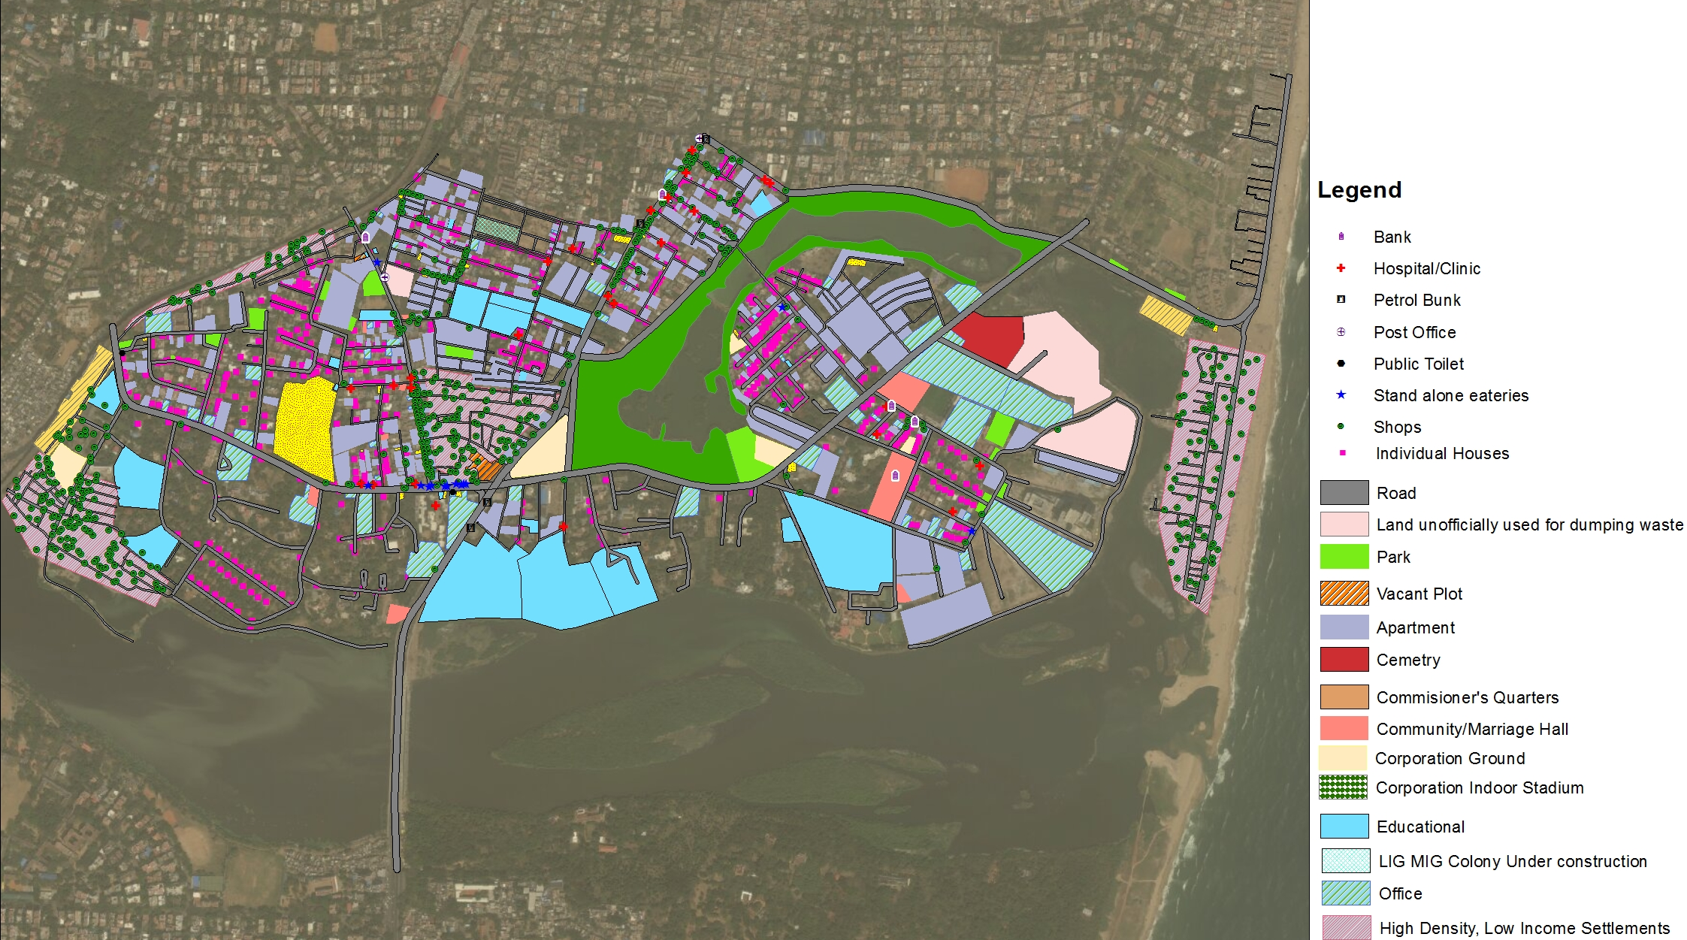
Map showing different waste generators
With roads, and waste related data this map can be used to plan for all SWM logistics accurately

Slide 20
Methodology
Sample Survey in Ward 173
Systematic random sampling used to select 5% of the households in the Ward for the survey
Mapping data used to determine sample
Results of the survey to be extrapolated for SWM solutions for the entire Ward
Sample survey conducted in two phases – Recruitment & Collection

Slide 21
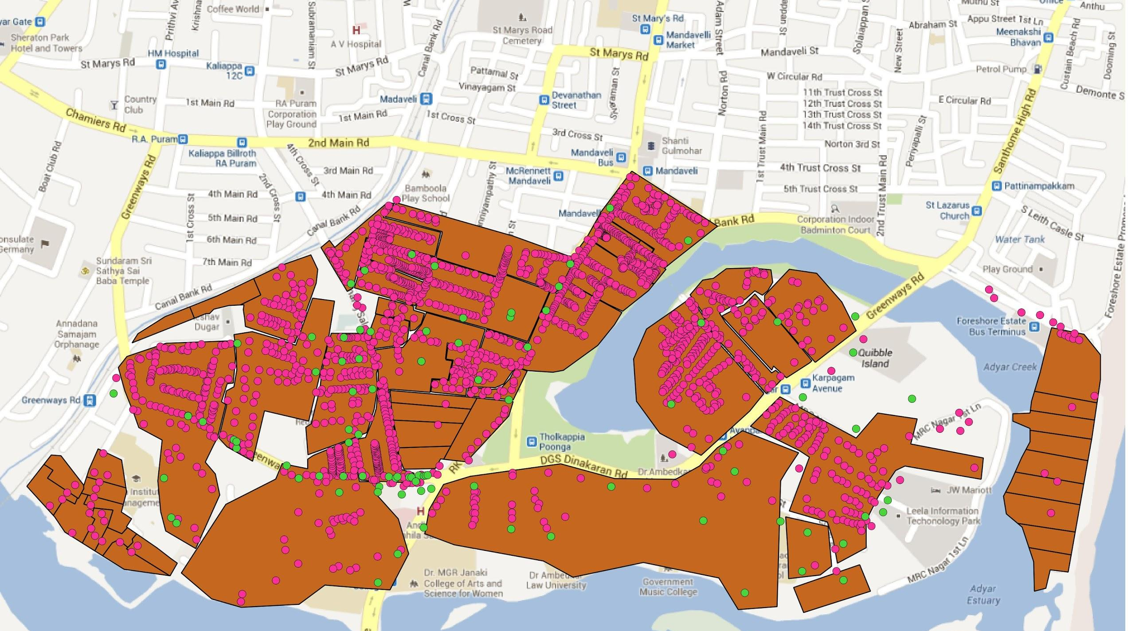
50 Blocks of 250-300 Households created
15 of 50 (30%) blocks selected at random

Slide 22
Methodology
Sample Survey in Ward 173: Recruitment
Within each of the 15 selected blocks, we selected 50 households (roughly 20%) and 4 shops per block using systematic random sampling
Recruitment involved approaching selected households and shops requesting their participation in the survey
Recruited units were provided dustbins for segregation, pictoral instructions, and garbage bags for nine days
Sample Size in Ward 173: 750 Households, 48 Shops

Slide 23
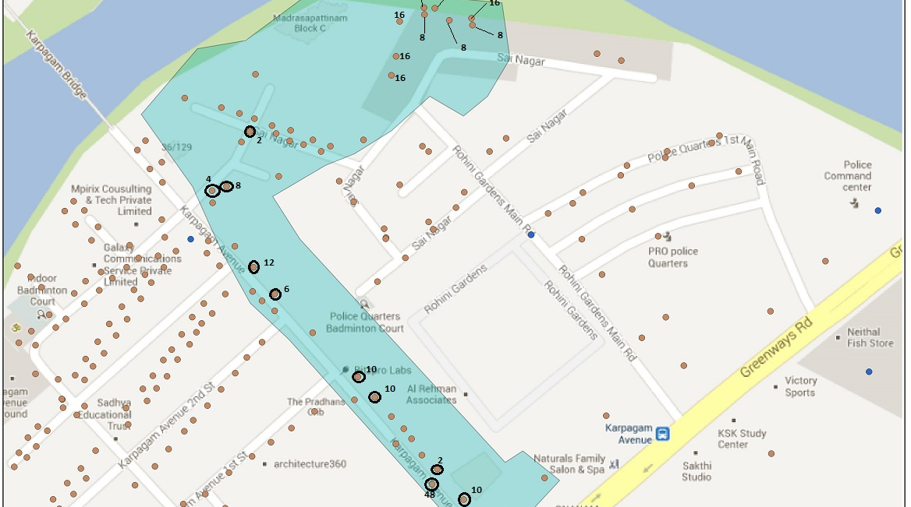
Block showing sample selection
Using Systematic random sampling

Slide 24
Methodology
Sample Survey in Ward 173: Collection
Segregated waste – organic, inorganic and sanitary – collected from the sample households & shops for nine consecutive days early every morning
Waste collected was then weighed & weight recorded for each category
Inorganic waste further segregated into recyclables and residuals

Slide 25
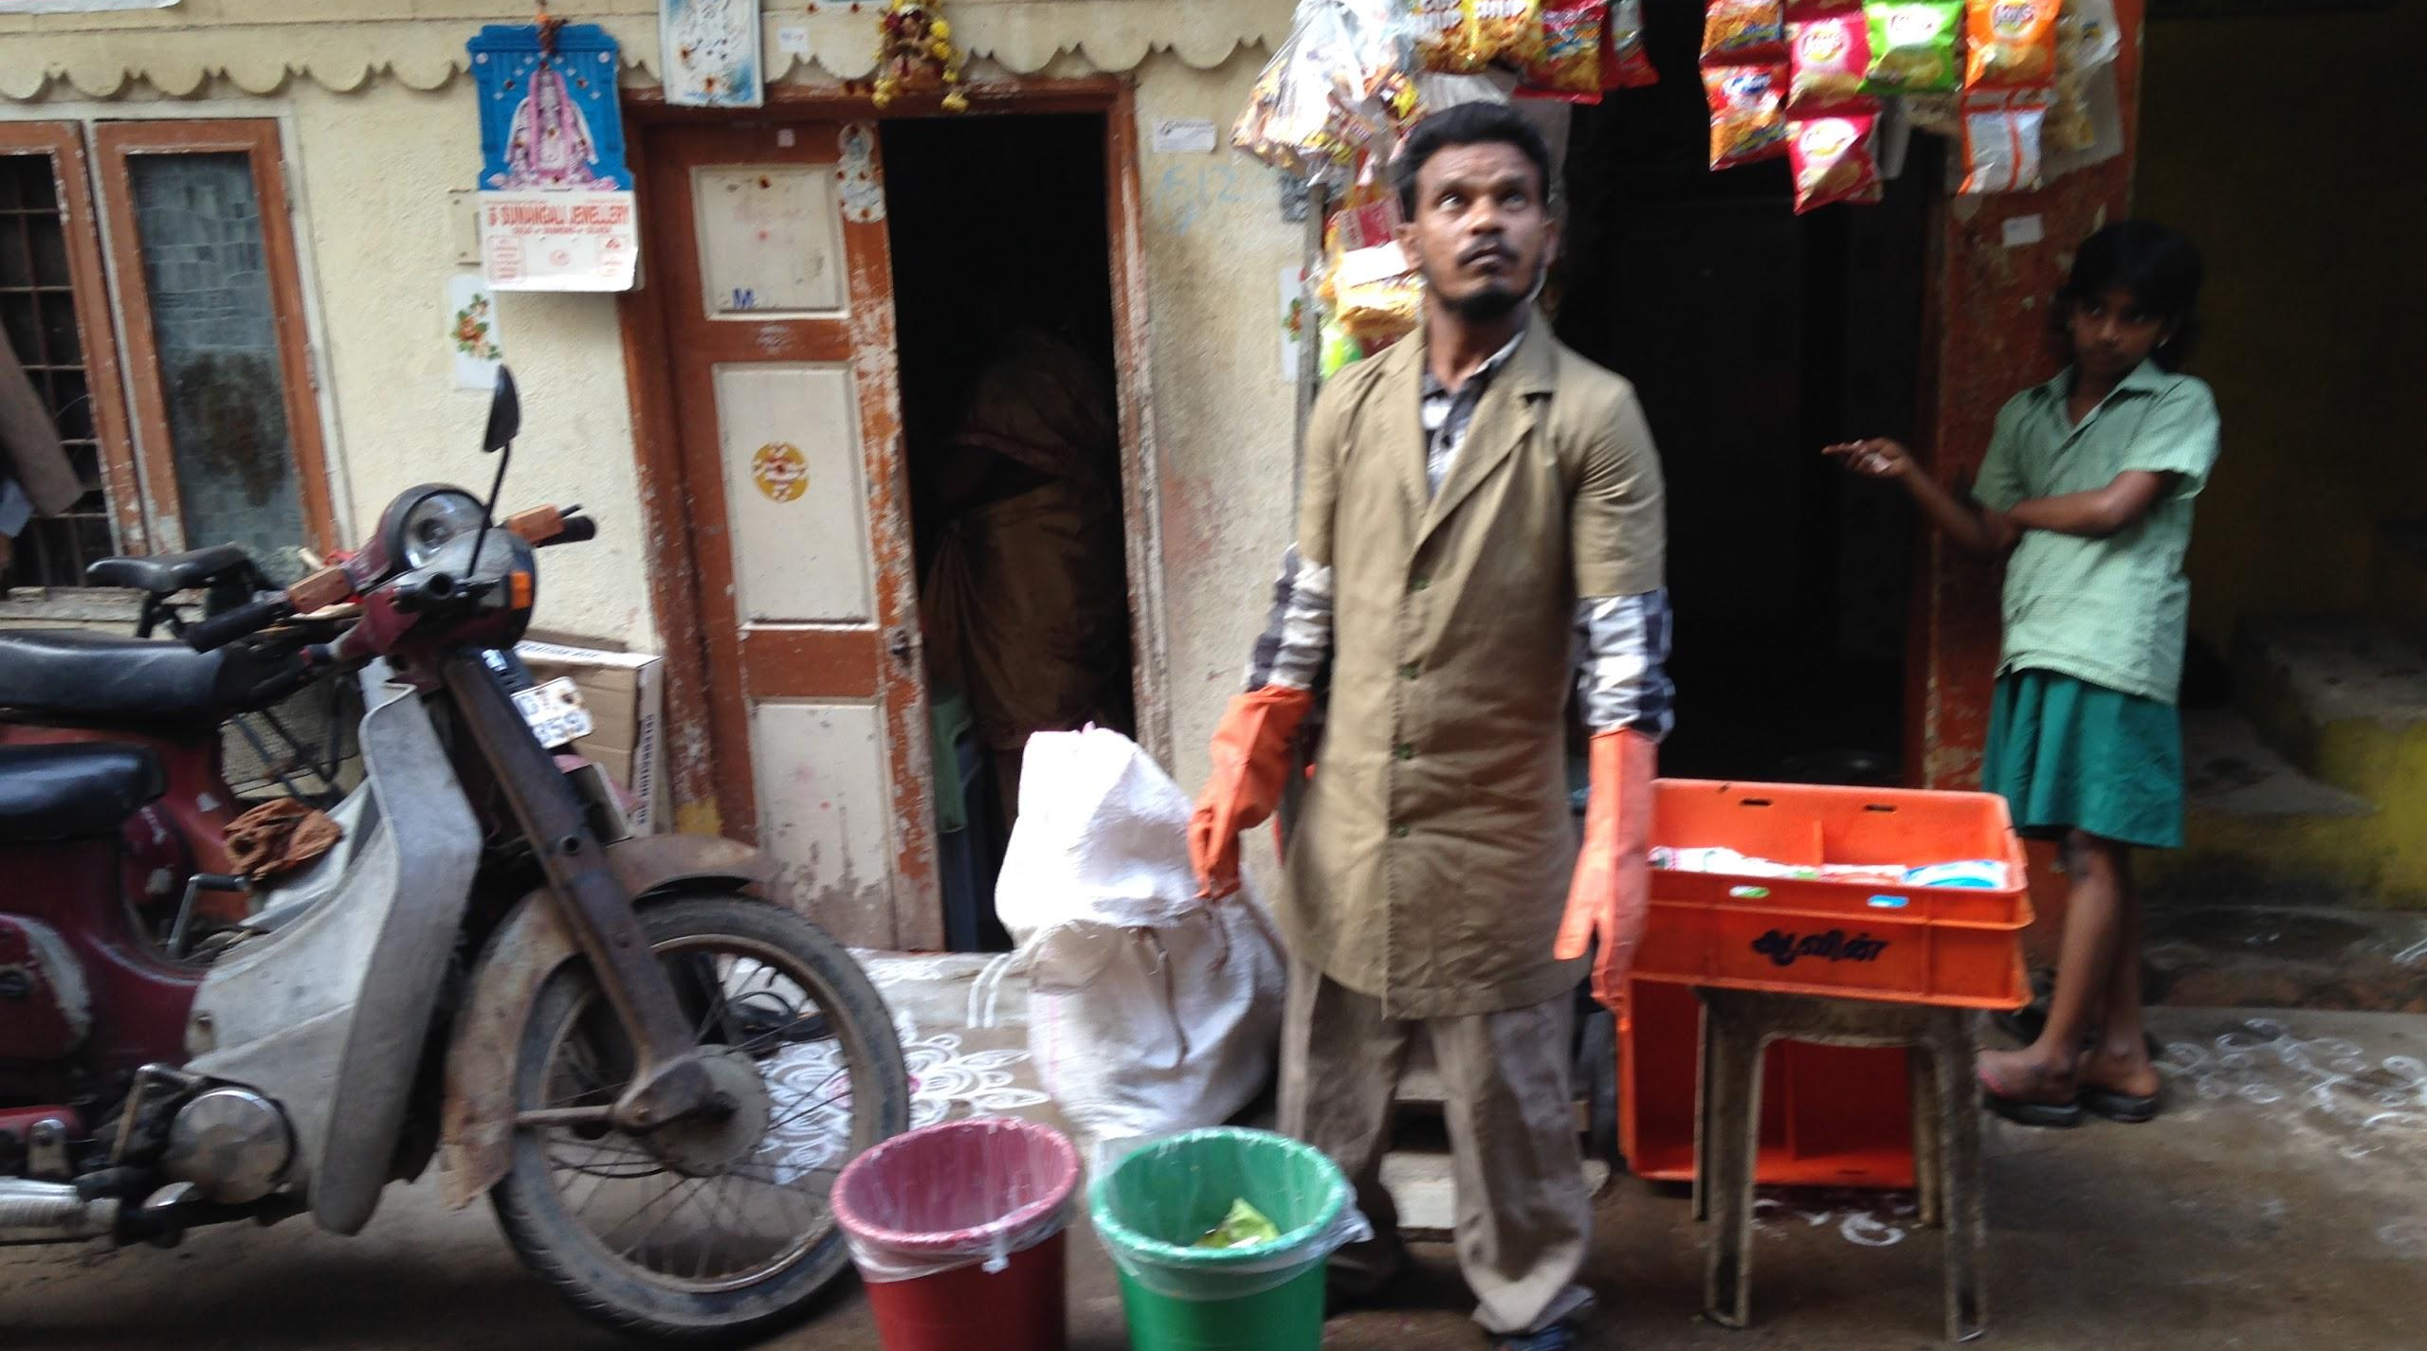
Segregated collection
Conservancy worker stands with segregation bins

Slide 26
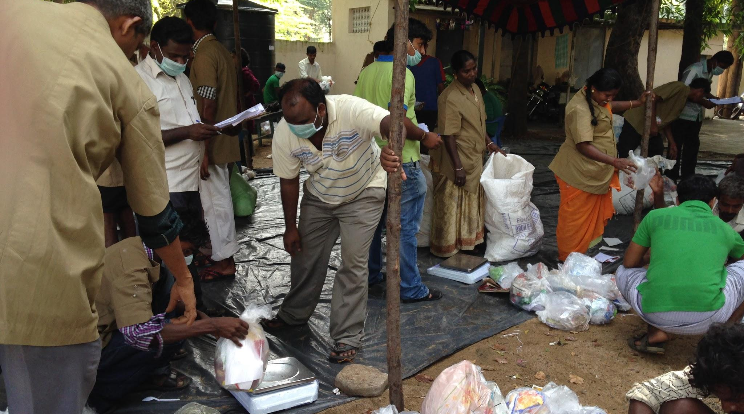
Weighing garbage bags
recording data on waste generation & Composition

Slide 27
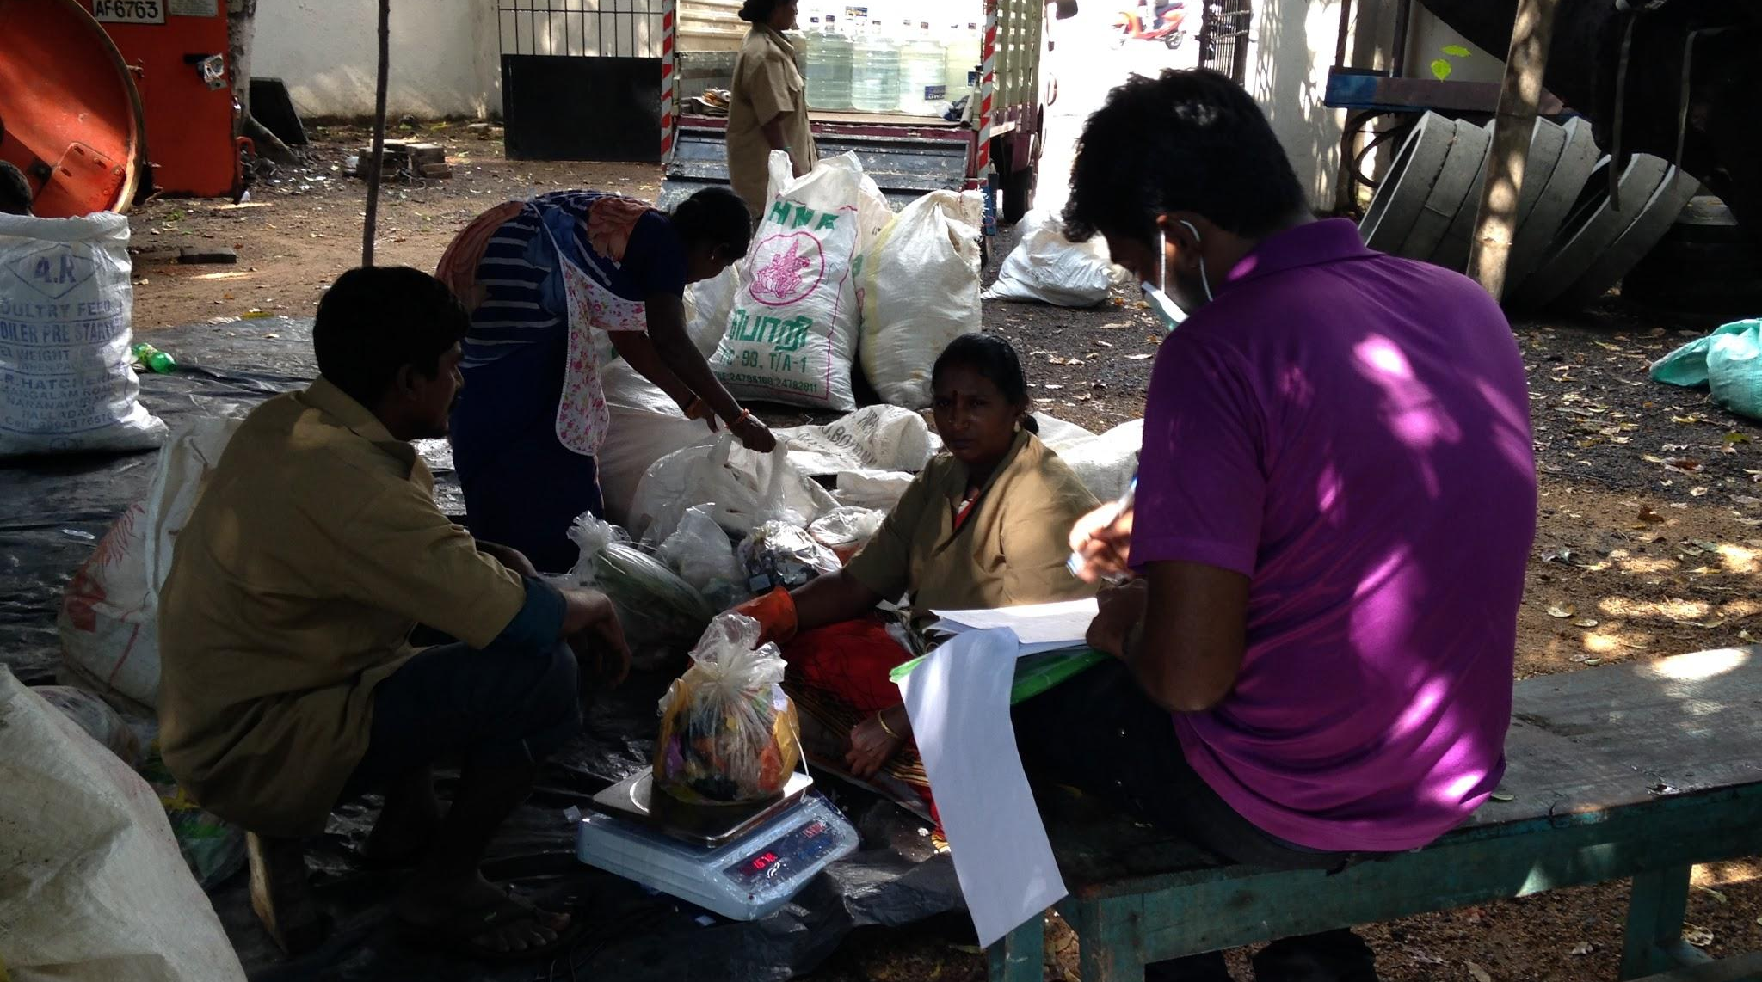
Weighing garbage bags
Recording data on waste generation & Composition

Slide 28
Planning from Data
Data for better decision making

Slide 29
Planning from data
Basic principles of waste hierarchy, protecting livelihoods, sustainability, inclusiveness, equity
Benchmarks and thumb rules: researched and compiled
Leveraging existing sustainable systems, such as the informal waste workers
For example:
  Number of units for collection per worker team = 200 to 220
  Optimal size of composting unit – not more than 2 MT
  Optimal size of biogas plant – 5 MT
  Optimal area for secondary segregation of dry waste: 1 MT = 1600 sq. ft.

Slide 30
Planning from Data
Example: Collection System for Ward 173
HH per Study | -Bulk HH per Study | +Shops per Study | Total Units for DTDC | No of Tricycles* | No. of workers**
14443 | 1532 | 945 | 13856 | 63 | 126
* Maximum capacity of 220 kg
** 2 per tricycle

Slide 31
Ward 173

Slide 32
Average Waste Generation per Household per day

Slide 33
Waste Generation by Households in Ward 173

Slide 34
Waste Generation by Shops in Ward 173

Slide 35
Primary Categorisation of Recyclable Waste

Slide 36
Percentage composition of recyclable waste
Ward 173

Slide 37
Total Estimated Waste Generation in Ward 173

Slide 38
Ward 173

Slide 39
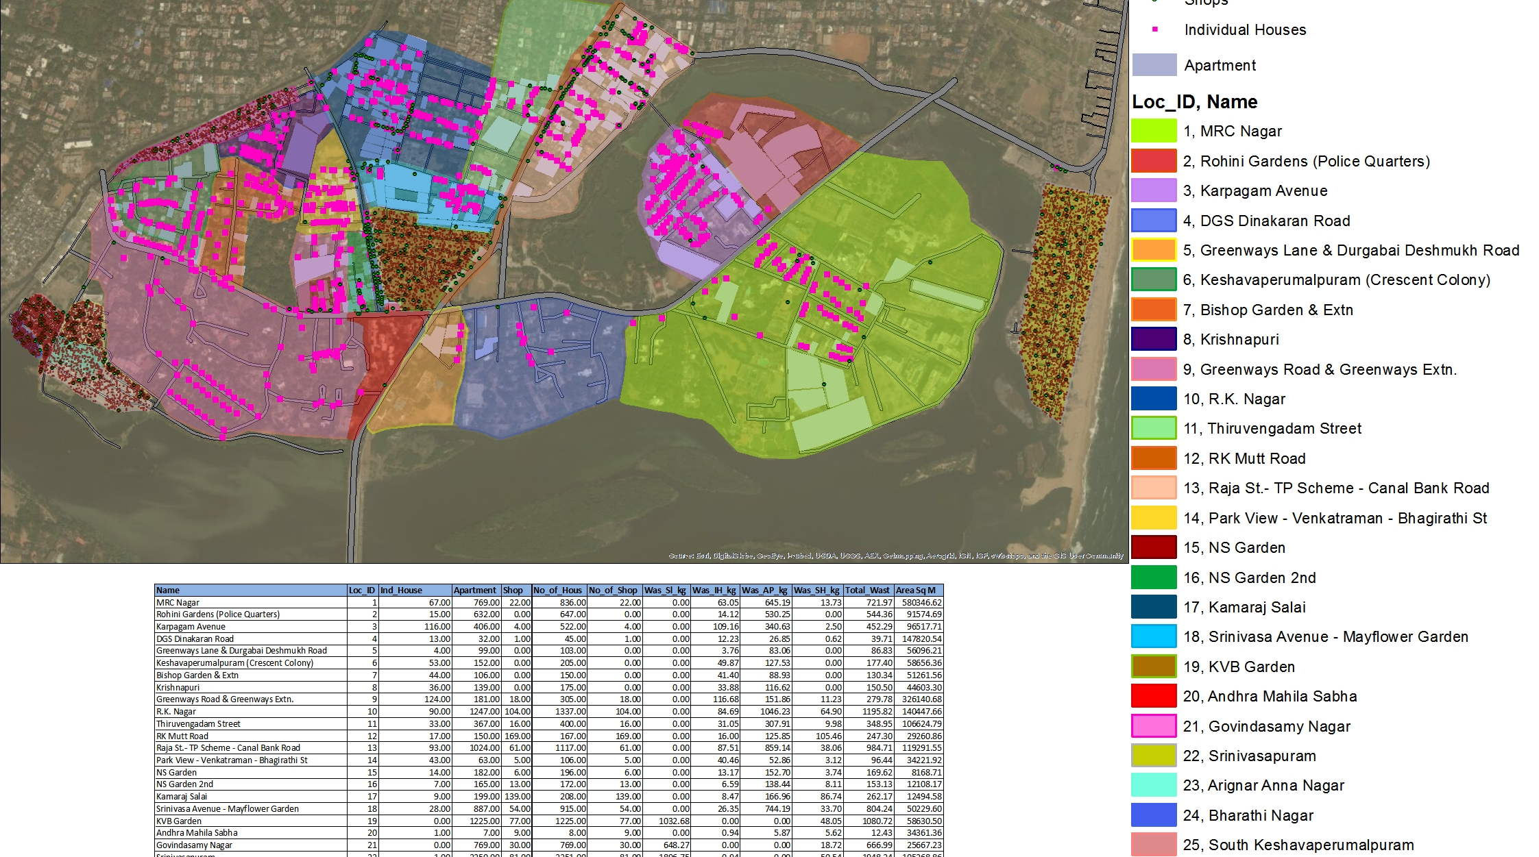
Visual Aids to planning
GIS analysis for planning

Slide 40
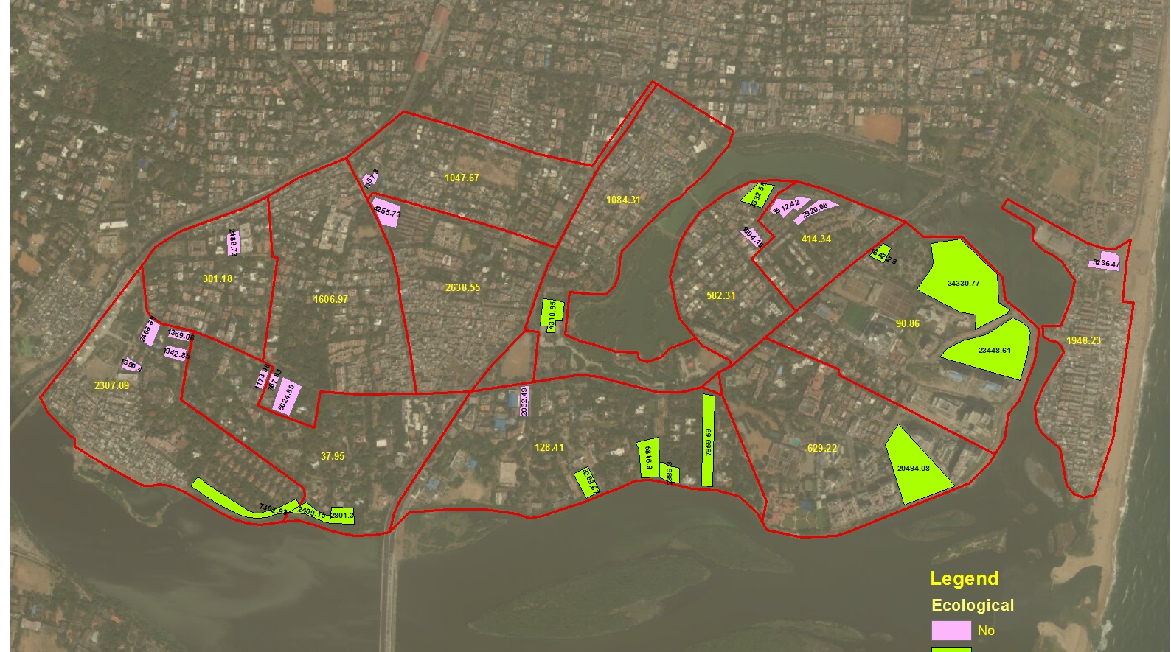
Open areas and amount of waste generated
Planning for resource recovery parks

Slide 41
Participatory Planning

Slide 42
Participatory Planning
At every stage
In Planning:
  The conception of a ward level pilot
  The pilot proposal based on data collected
In Data Collection: mapping, surveys, etc.
In Conceptualising: through community meetings, one-on-one interactions, and distribution of flyers
Implementation: citizen monitoring committees, etc.
  Necessary for public consultation prior to deciding location of RRPs

Slide 43
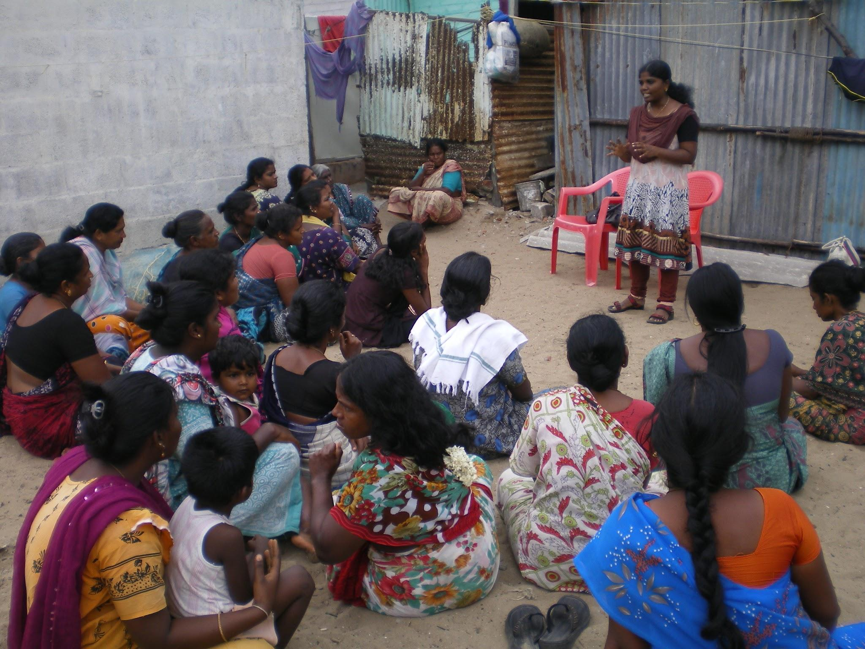
Community meeting to present findijngs
Srinivasapuram, Ward 173

Slide 44
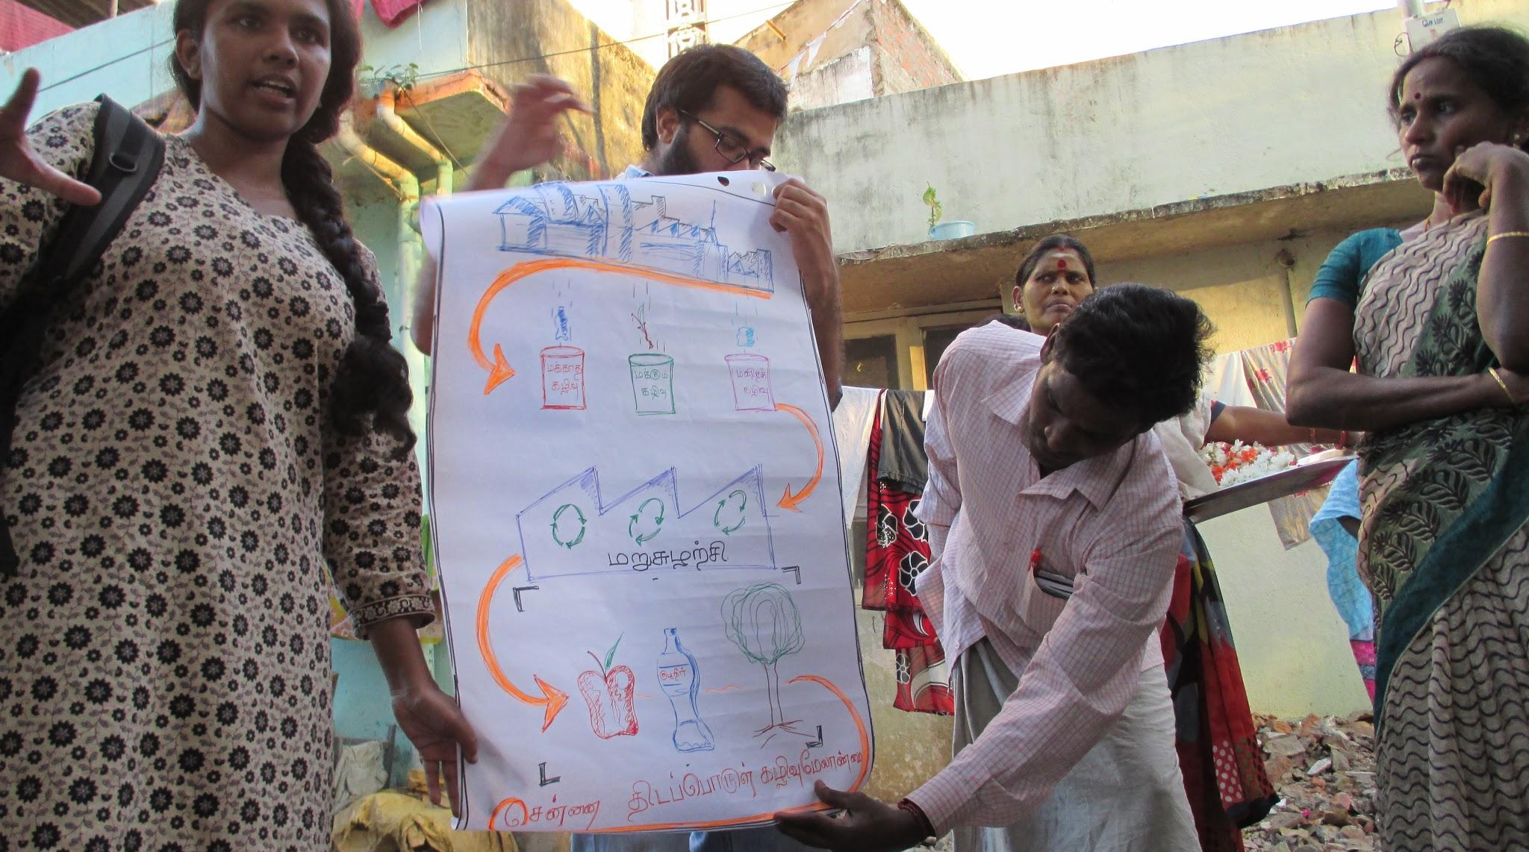
Community meeting workshopping the Ward 173 proposal
Govindasamy nagar, Ward 173

Slide 45
Adapting the methodology for different contexts

Slide 46
Adapting according to context
The simple question is:
What do we need to know to plan better?
Low cost & Low tech.
Waste Diagnostic Toolkit; Waste Diagnostic Report.

Slide 47
Thank you!
Questions?

