Slide 1

Clubbing Public Financing of Coal and Climate Change
Niraj Bhatt
Consultant Researcher
Email: niraj.bhatt@cag.org.in
tpp@cag.org.in

Slide 2

35-year old non-profit and non-political organisation that works to empower citizens, promote transparency and accountability, and harness new technologies to strengthen governance.

Slide 3
What happens to depositors’ money in bank?
Banks use depositors’ money to invest and lend to various sectors.
The sectors are based on profitability and on government signals (priority sector lending).
Coal sector is one of the various sectors that banks invest/lend money in. Coal sector includes coal mining, coal-based power generation and transmission.
Public sector banks due the nature of their own funding, put up more of our (public) money into such projects.

Slide 4
Depositor versus Shareholder in bank – how does it matter?
I own 1 share of a bank worth Rs.1,000/-
My friend has a fixed deposit of Rs.10,00,000/- in the same bank.
I get a vote in the AGM of the bank whereas my friend who has 1,000 times more money than me has no vote.
Should depositors have the basic right to make sure their money is not used for environment and human rights violations?

Slide 5
Banks invest wherever they like - Why bother?
Banking on Climate Change 2020 highlights that 35 private sector banks have together channelled USD $2.7 trillion into fossil fuels since the Paris Agreement was adopted (2016-2019).
Of this, 30 top coal mining projects have received USD $54.462 billion while 30 top coal-based power have received USD $138.524 billion between 2016 to 2019.
Such financing of the fossil fuel industry weakens the global efforts to stay within the 1.5°C.
Global financial system is financing activities and industries that can ramp up the global temperature by more than 4°C and financing worth USD 85 trillion had already been secured by carbon intensive industries
Notes:
2. Overall, 343 coal power projects globally for 300 GW of new capacity addition (up to 2030). India has plans for approx. 59,000 MW of new coal plants
3. Natural disasters in the last two decades have already doubled and most of these are linked to climate change related extreme weather events like flooding, droughts and storms.
4. In October 2019, the then Bank of England’s governor, Mark Carney remarked that the----

Slide 6
What is the issue with coal?
Mining and burning coal releases smoke and leaves behind ash, both of which have chemicals that are harmful to the environment (air, water and soil) and human health.
Phase out of coal-fired power plants alone has annual GHG reduction potential of 4 gigatons of CO₂ by 2050; just this would be about 10% of 2010 total emission levels (46 gigatons).
An increase of 1 GW of coal-fired power generation capacity in India increased infant mortality rate by 15% in districts near coal-fired power plants as compared to those that are away.
Notes:
3. For the period between 1996 to 2014, a study concludes that ----

Slide 7
Coal in India
India is the second biggest individual driver of primary energy consumption growth, which rose by 2.3% last year.
India’s energy-related CO₂ emissions continued to rise to 2,480 million tons of CO₂ in 2019, and coal represents 73% of total electricity generation in India.
63% of the 200 gigawatts (GW) of installed capacity of coal fired power plants, is owned and operated by the state.
Notes:
1. Behind China,
MoEFCC budget allocation down to Rs.2869.96 Cr, from Rs.3100 Cr

Slide 8
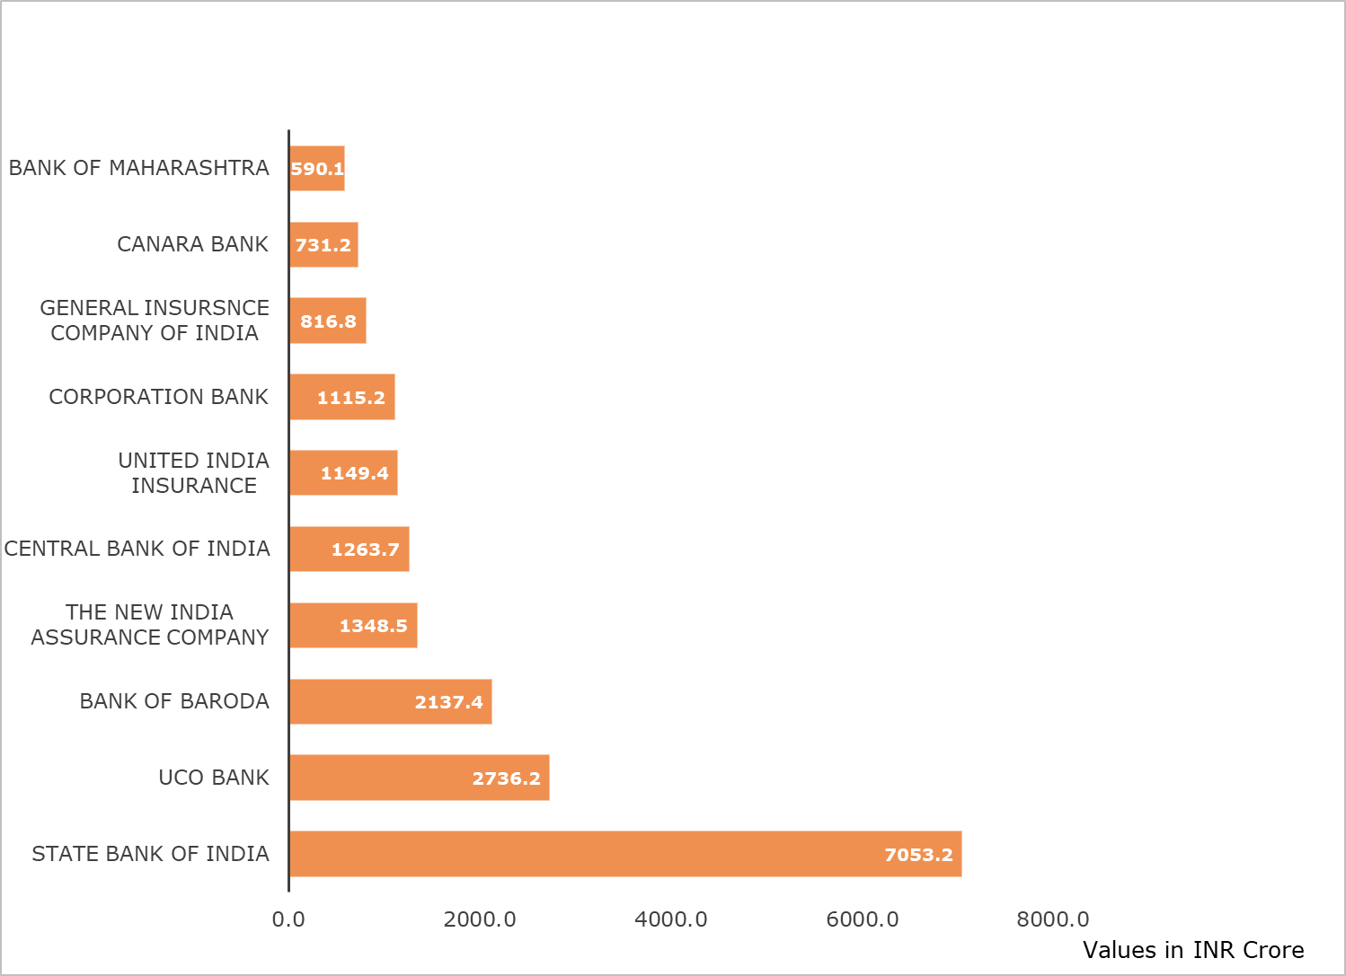
Banks and insurance companies’ investments in Coal*

Slide 9
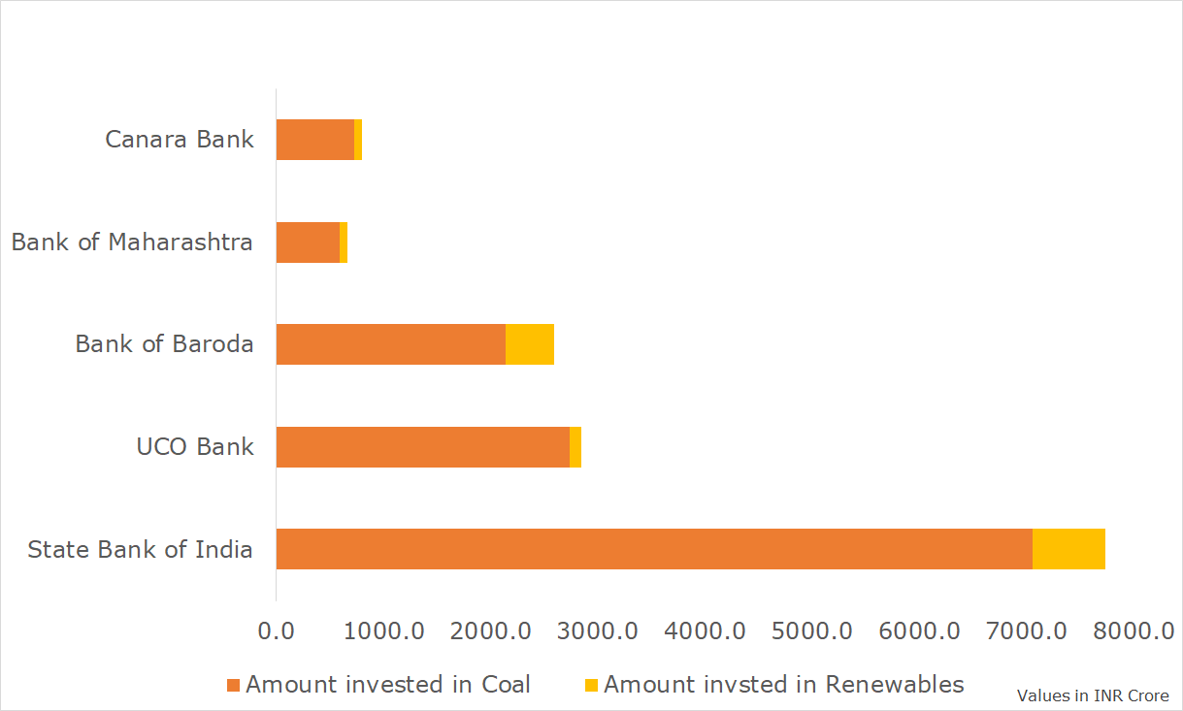
Comparison of Public Sector Banks investments in Coal* and Renewables

Slide 10
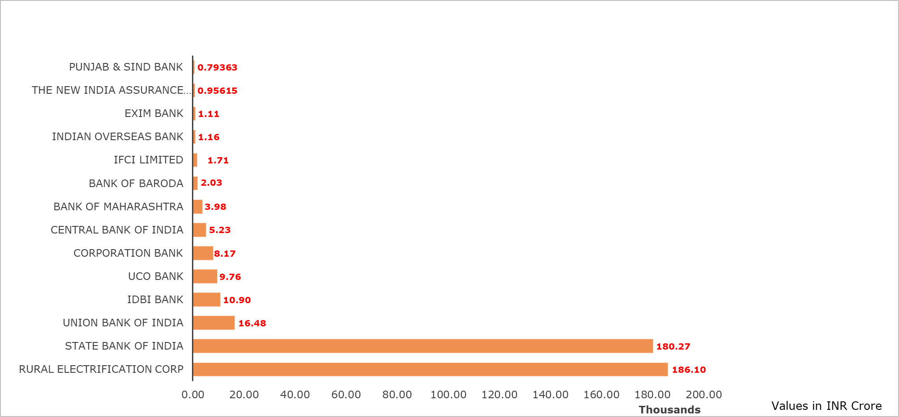
Public sector banks having credit exposure (outstanding loans) to coal*

Slide 11
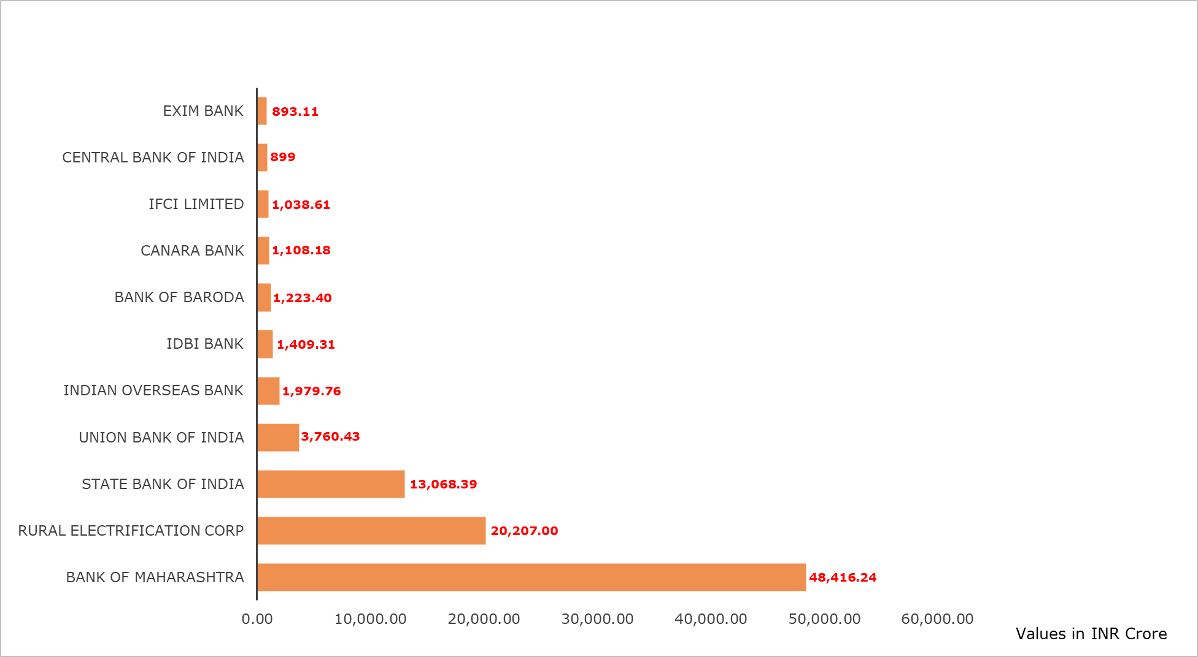
Public sector banks having NPAs in coal*

Slide 12
Why is the marriage between coal and public sector financiers in doldrums
No coal linkages, disputed coal block allocations, no power purchase agreements.
Cost overruns due to coal price movements, litigations over environmental and social concerns
Fierce competition from renewable sources of energy, primarily solar and wind.
Aggressive tariff bidding, delayed payments by distribution companies.

Slide 13
Thank you
Get in touch at
Email - tpp@cag.org.in
Twitter - @ThermalWatch
@CAGChennai
Facebook - CAGChennai

