Slide 1

Tangedco’s Recipe for Recovery
Retiring old coal, stopping new build,
boosting RE
Climate Risk Horizons
Image: evening_tao / Freepik

Slide 2
TANGEDCO’s financial crisis
~22,000 cr. dues
Cost of supply – revenue gap ~Rs 2/kWh.
New capex required to meet emission norms
Background:
Surplus generation capacity (PLFs of coal fleet in TN - <60% since FY2017)
New RE cheaper than most existing coal, RE+ storage cheaper than new coal
Capex to meet emission control deadline – Dec 2020
3.1 GW of new coal nearly complete, due to be commissioned soon
3.5 GW of new coal at early stages of construction
What cost saving opportunities exist in this scenario?

Slide 3
Assumptions & Methods:
Benchmark of >4/kWh coal power as “expensive”; new RE at 3/kWh
FGD & LNB costs based on CEA estimates
Plants analysed based on:
Age
PCT installation status (CEA Sept ‘20 quarterly report)
Tariffs (Tariff Order, FY2017-2019)
Potential savings based on scheduled dispatch in tariff order

Slide 4
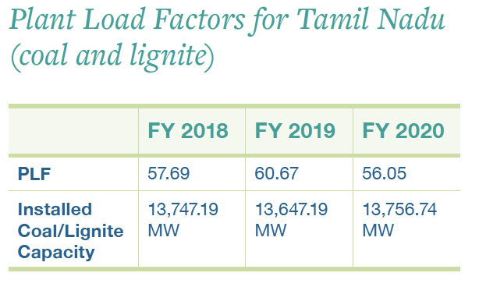
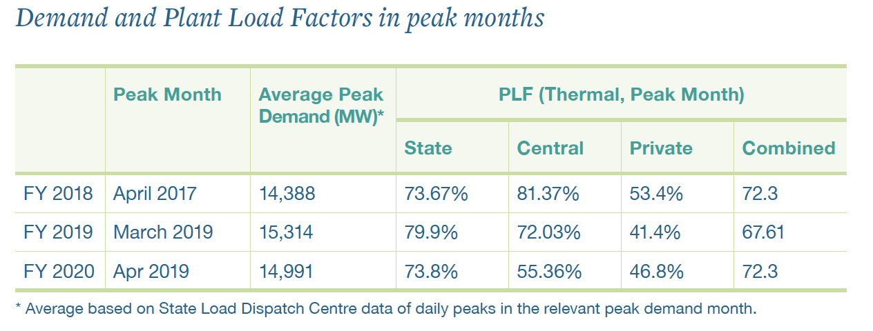
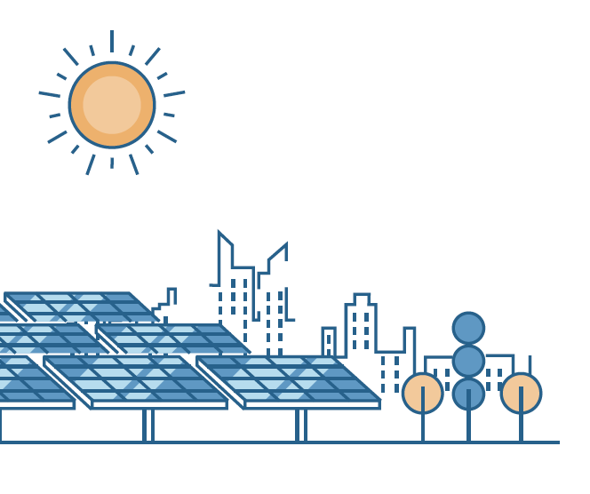
Does TN have sufficient backup for peak periods?

Slide 5
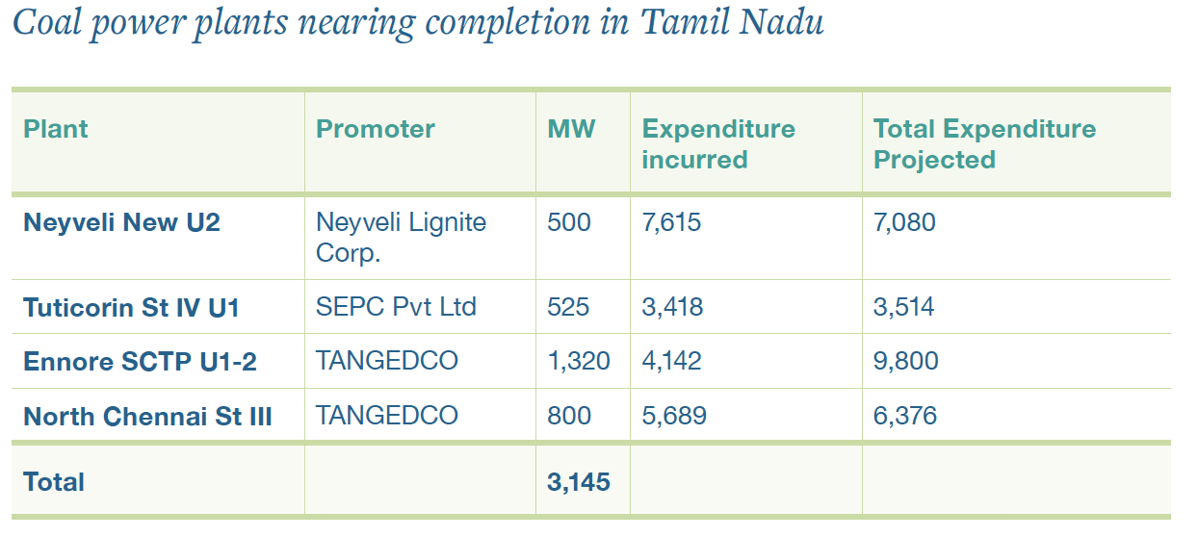
Does TN have sufficient backup for peak periods?
3.1 GW new coal due to be commissioned soon

Slide 6
Demand projections not realised
Demand has been growing at 2.87% since FY2018.
CEA projects 16,800 MW peak demand in FY2021.
Tangedco had projected peak demand in FY2020 at 18,841 MW.
At current rates (~3% CAGR), this level will only be reached by 2025
Building new coal is NOT the most cost-effective way to cater to future demand
RE + storage + rural solar + efficiency
Increase PLFs of existing plants
Market purchases

Slide 7
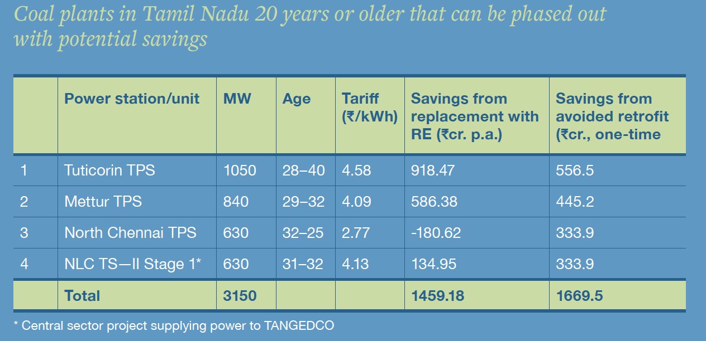

Slide 8
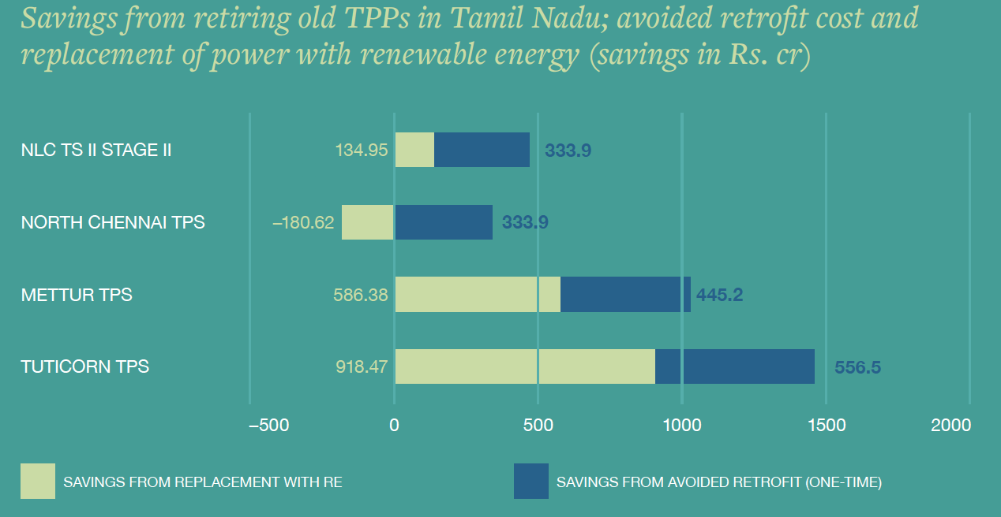
9,000 cr = Savings from retirement of 3.1 GW old plants
1,670 cr - avoided PCT retrofits
1,459 cr p.a. in lower power purchase costs (assuming RE@ 3/kWh) =
9,000 cr over 5 yrs

Slide 9
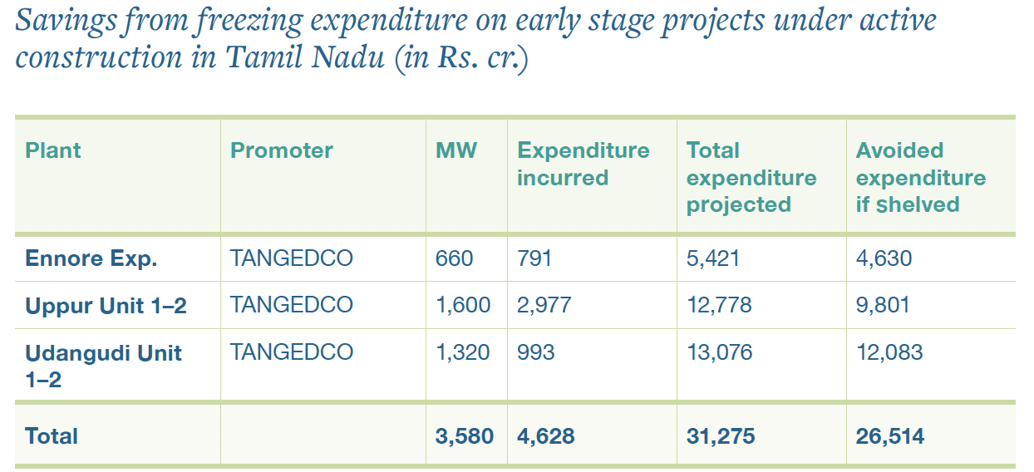
26,000 cr = Savings from freezing new construction

Slide 10
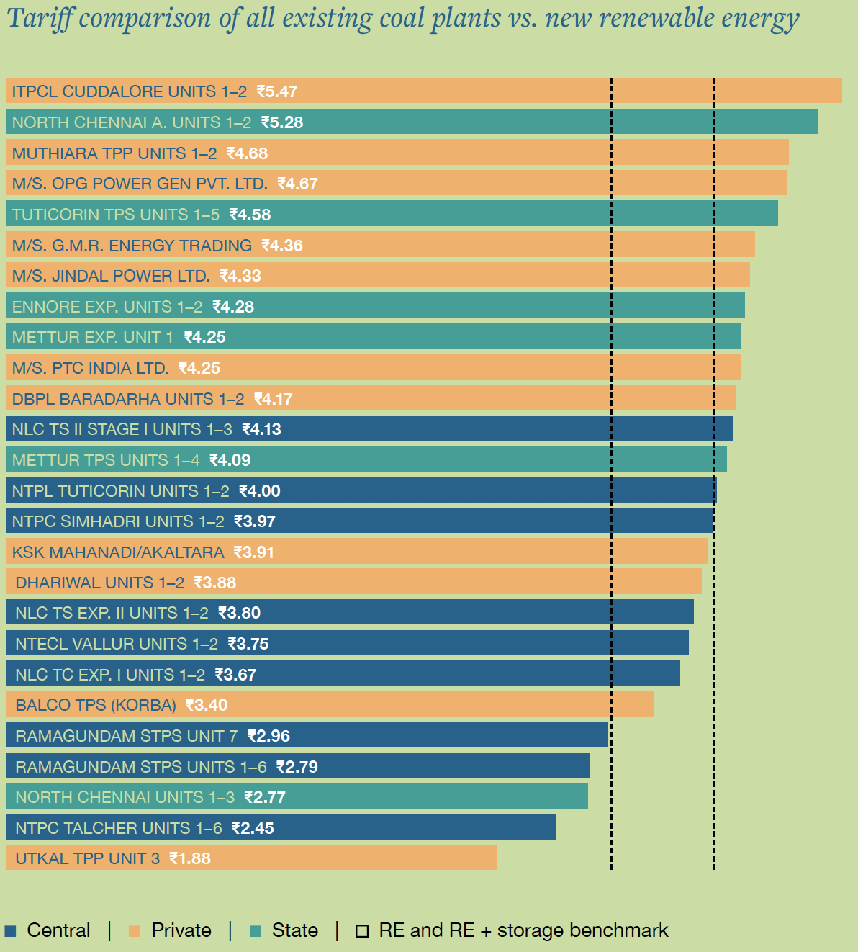
30,000 cr = Savings over 5 years from phasing out all coal power >4/kWh
Long term: RE key to reducing power purchase costs

Slide 11
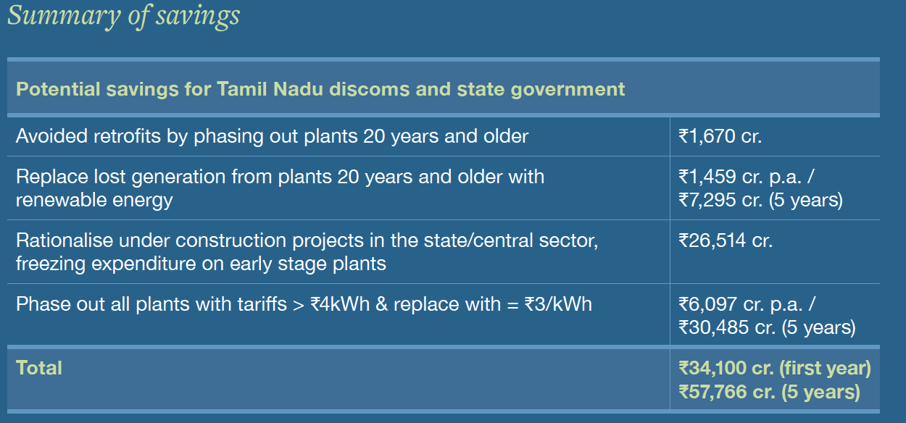

Slide 12
In Conclusion…
Significant $$ benefits to retiring 3.1 GW of old coal plants >28 yrs –Avoided retrofit costs & lower power purchase costs through replacement with RE
Halting further expenditure on coal plants that are in the early stages of construction is vital if Tangedco is not to lock itself into expensive power purchase / fixed cost obligations.
Repurposing of land and equipment from retired units can defray costs and help with the transition
Savings can be leveraged to rural / agri solar, efficiency and other loss reduction avenues
Long term: RE key to reducing power purchase costs
TBD – resolution of outstanding fixed costs to enable retirement/repurposing?

Slide 13

Thank You!
Image: evening_tao / Freepik

